Slide 1
Blonded.co
Information Architecture Research

Slide 2
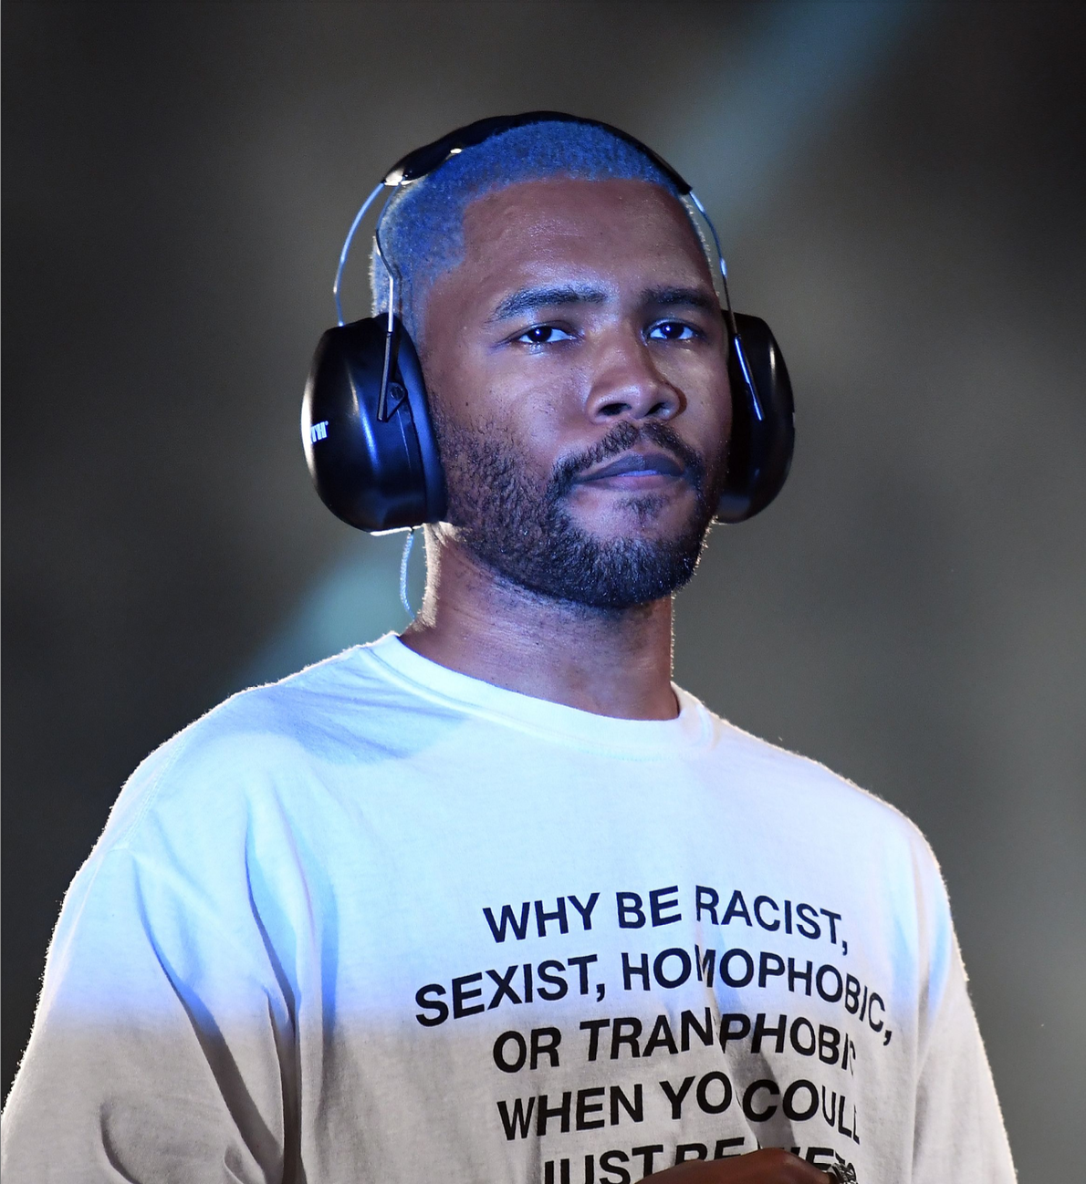
Improving User Experience on Frank Ocean's Website
In this guide, we'll break down the essential elements of a website analysis and how you can improve user experience. From identifying target audiences and streamlining user flows to optimizing page load times and enhancing content quality, we'll cover all the key areas to help your website stand out and resonate with your users.

Slide 3
About Frank Ocean
Frank Ocean is a Grammy-winning American singer, songwriter, and record producer known for his distinctive style and unique approach to music. Born Christopher Edwin Breaux in Long Beach, California, in 1987, Ocean began his music career as a songwriter for artists such as Beyoncé, Justin Bieber, and John Legend. He gained fame as a member of the hip hop collective Odd Future, where he released his first mixtape, Nostalgia, Ultra, in 2011.

Slide 4
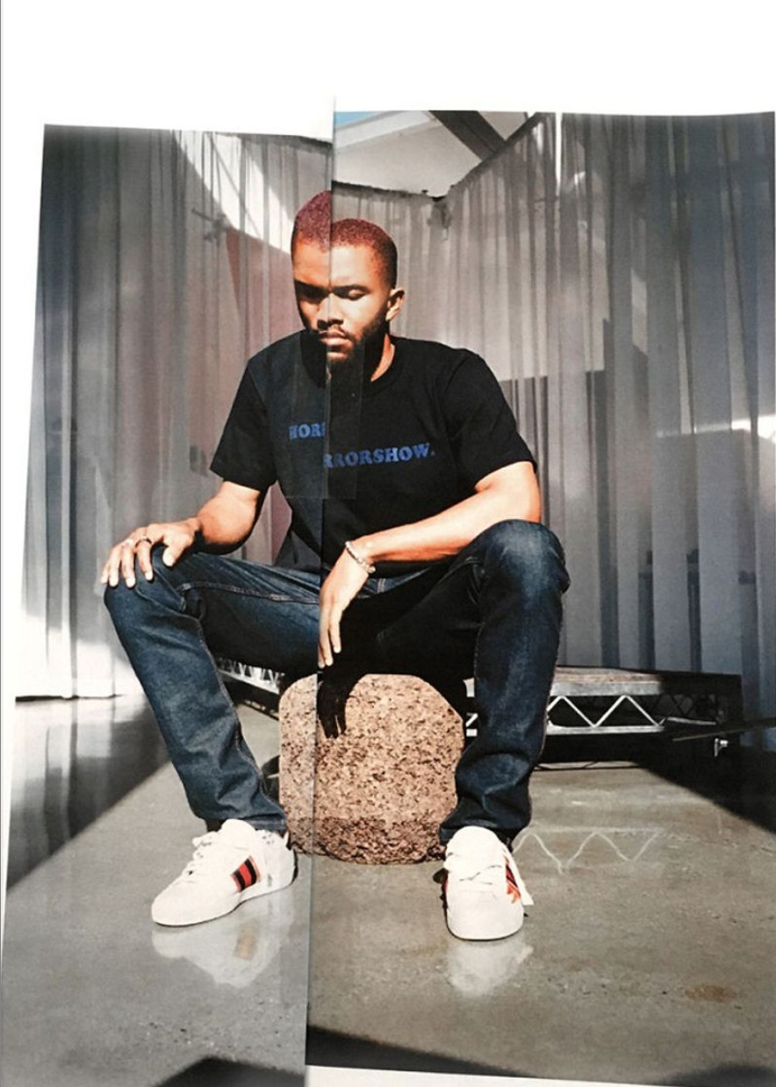
Project Objectives and Target Audience
Frank Ocean's website is an essential platform for the artist to engage with fans and promote his work. As such, it is crucial that the website provides a positive user experience that is intuitive, accessible, and engaging for all users.
To ensure this, it is necessary to analyze the website's design, content organization, navigation, accessibility, and user engagement. By conducting a comprehensive analysis of these areas, we can identify any potential issues or areas for improvement and provide recommendations for enhancing the user experience. This website analysis will aim to provide these recommendations, helping to improve the overall user experience and make the website more accessible and user-friendly for all users.

Slide 5
Website Goals
Increase Fan Engagement: The website's design and content aim to encourage users to engage with Frank Ocean's music, share it with others, and purchase his merchandise

Slide 6

Intended User Base
Frank Ocean Fans: The website's primary target audience is Frank Ocean's fans who are interested in his music, want to keep up with his latest releases, and purchase his merchandise.
Music Lovers: The website may also attract music lovers who are interested in exploring new music and discovering new artists.

Slide 7
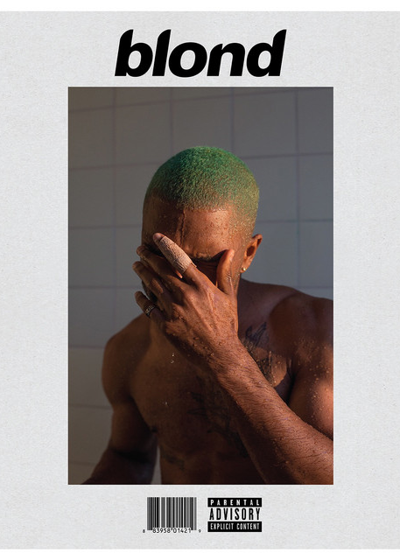
Users' Needs and Expectations
Easy Navigation: The website's design and layout make it easy for users to navigate through different sections and find the information they are looking for.
User-Friendly Interface: The website's user interface is simple, clean, and visually appealing, making it easy for users to focus on the content and engage with it.
Responsive Design: The website is designed to be responsive and accessible on different devices, including desktops, tablets, and mobile devices.
Engaging Content: The website features engaging content, including Frank Ocean's discography, merchandise, and official music videos, which cater to users' interests and expectations.
Secure Transactions: The website provides a secure platform for users to purchase Frank Ocean's merchandise, ensuring that their personal and financial information is safe and protected.

Slide 8
Friction points and areas of confusion
There are several friction points and areas of confusion on the website. One of the main friction points is the repetitive content that appears on multiple pages, such as the merchandises being listed on the All page and the homepage. Additionally, the Share and Link buttons under the photos and videos may confuse the user as it is unclear what happens when the user clicks on these buttons. The lack of search functionality may also be a friction point for users who are trying to find specific content.
Confusion with the link-sharing functionality under photos.

Slide 9
Site Structure
Search Functionality
The site structure appears to be straightforward, with a primary navigation bar at the top of the page that includes options for All, Photo, Video, and Audio. Clicking on any of these options takes the user to a separate page where the relevant content is displayed. There is also a Subscribe option on the top left corner and a Cart on the top right end. However, the user may find it confusing that some of the content appears on multiple pages, such as the merchandises being listed on the All page and the homepage.
one page layout with multiple sections-blonded
There does not appear to be a search bar or any other search functionality available on the website, which could make it difficult for users to find specific content.

Slide 10
Content Organization
Main Navigation and Menus
Labeling and categorization system
The content is organized in a logical manner with different sections for different types of content such as Photo, Video, Audio, and Merchandise. However, some of the content appears to be repetitive or irrelevant. For instance, the cart option seems out of place on the homepage, and the current date and time on the navigation bar may not be relevant to the user.
The main navigation and menu appear to be simple and easy to use. However, some of the labeling, such as the "All" option, may not be entirely clear to the user. Additionally, the placement of the Cart option on the top right end of the page seems odd and may not be intuitive to some users.
The labeling and categorization system is generally clear, with separate sections for different types of content such as Photo, Video, Audio, and Merchandise. However, some of the content seems to overlap, such as the merchandises being listed on the All page and the homepage.
Content organized under ALL, PHOTO, VIDEO, and AUDIO tabs.

Slide 11
Things to Add:
Clear and concise messaging on the homepage to communicate Frank Ocean's brand and message.
More music on the audio page to provide users with more options to listen to and engage with his music.
Categorization and labeling on the all page to make it easier for users to find the content they are looking for.
Customization options for the subscription form to allow users to choose the type of content they want to receive.
Social media integration on the subscription form to provide users with an additional way to stay connected with Frank Ocean's latest news and updates.

Slide 12
Things to Remove:
Confusing question on the subscription form that can cause confusion for users.
Duplicate content from the other pages on the all page to simplify the design and reduce clutter.
Screenshot of Spotify playlist on the audio page to provide a better user experience.
Confusing share and link buttons on the photo and video pages that can cause confusion for users.
Overwhelming list of content on the all page that can be categorized and labeled to make it easier for users to find what they are looking for.

Slide 13
Improving the Home Page of Frank Ocean's Website
A. Featured Content
The addition of featured content such as new album releases, upcoming concert dates, or exclusive interviews can help draw users in and keep them engaged.
B. Social Media Integration
Integrating social media feeds, such as Twitter or Instagram, can help users stay up-to-date on Frank Ocean's latest news and interact with other fans.
C. Call-to-Action Buttons
Adding more prominent calls-to-action, such as "Subscribe" or "Buy Now" buttons, can encourage users to engage more with the website and the artist's work.
D. Featured Merchandise
Adding a section to the home page featuring new or popular merchandise can help increase sales and engage users who are interested in buying merchandise.

Slide 14
Evaluation of Website
Blonded.co performs well in the areas of visibility of system status, error prevention, and recovery features. However, it lacks consistency and standards, and often provides poor error messages and help features. My recommendation is to create more consistency across the website and provide more clear and helpful error messages and help features.
Usability testing of Blonded.co's key features such as the product pages and checkout process revealed that while they were generally easy to use, users experienced issues with slow load times and unclear layout. My recommendation is to optimize website performance and simplify the layout to eliminate unnecessary elements that slow down load times.

Slide 15
Heuristics and information architecture (IA) of the website.
Design Principles: The website utilizes a minimalist design, which is consistent with Frank Ocean's overall aesthetic. The use of whitespace and simple typography makes the site visually appealing and easy to read.
Consistency and Standards: The website maintains a consistent layout, with the main navigation bar at the top of the page. The site's typography, colors, and imagery are also consistent throughout, ensuring a cohesive and seamless user experience.
Navigation and IA: Blonded.co's IA is straightforward and easy to understand. The site is divided into the following sections: Home, Music, Merchandise, Tour, and About. Each section is accessible via the main navigation bar, making it easy for users to find the content they are looking for.
Flexibility and Efficiency of Use: The website is responsive, which means it adapts to different screen sizes and devices. This allows users to access the site from various devices, ensuring an efficient and flexible browsing experience.
Error Prevention and Recovery: While the site's minimalist design reduces the likelihood of user errors, any potential issues can be quickly resolved by using the main navigation bar to return to the desired section. Additionally, a search feature would enhance the user experience by enabling users to find specific content more efficiently.
Aesthetic and Minimalist Design: As mentioned earlier, Blonded.co employs a minimalist design that emphasizes content over flashy design elements. This approach enhances the overall user experience by reducing distractions and focusing on what's important: Frank Ocean's music and related content.
Help and Documentation: While the site does not provide explicit help or documentation, the straightforward design and clear navigation make it easy for users to explore and understand the website without the need for additional guidance.
Overall, Blonded.co features a well-designed IA and effective heuristics that create a positive user experience. The minimalist design, consistent visual elements, and clear navigation contribute to the site's ease of use and accessibility. However, the site could benefit from the addition of a search feature to further enhance the user experience.

Slide 16
Mobile Responsiveness Evaluation
Blonded.co is responsive to mobile devices, but some users experienced issues with slow load times and difficulty navigating menus due to the small screen size.
After evaluating the mobile responsiveness of Blonded.co, I found that while it is responsive to mobile devices, there are still some issues with slow loading times and difficulty navigating menus due to the small screen size. My recommendation is to optimize website performance for mobile users and simplify the navigation menu for ease of use on smaller screens.

Slide 17
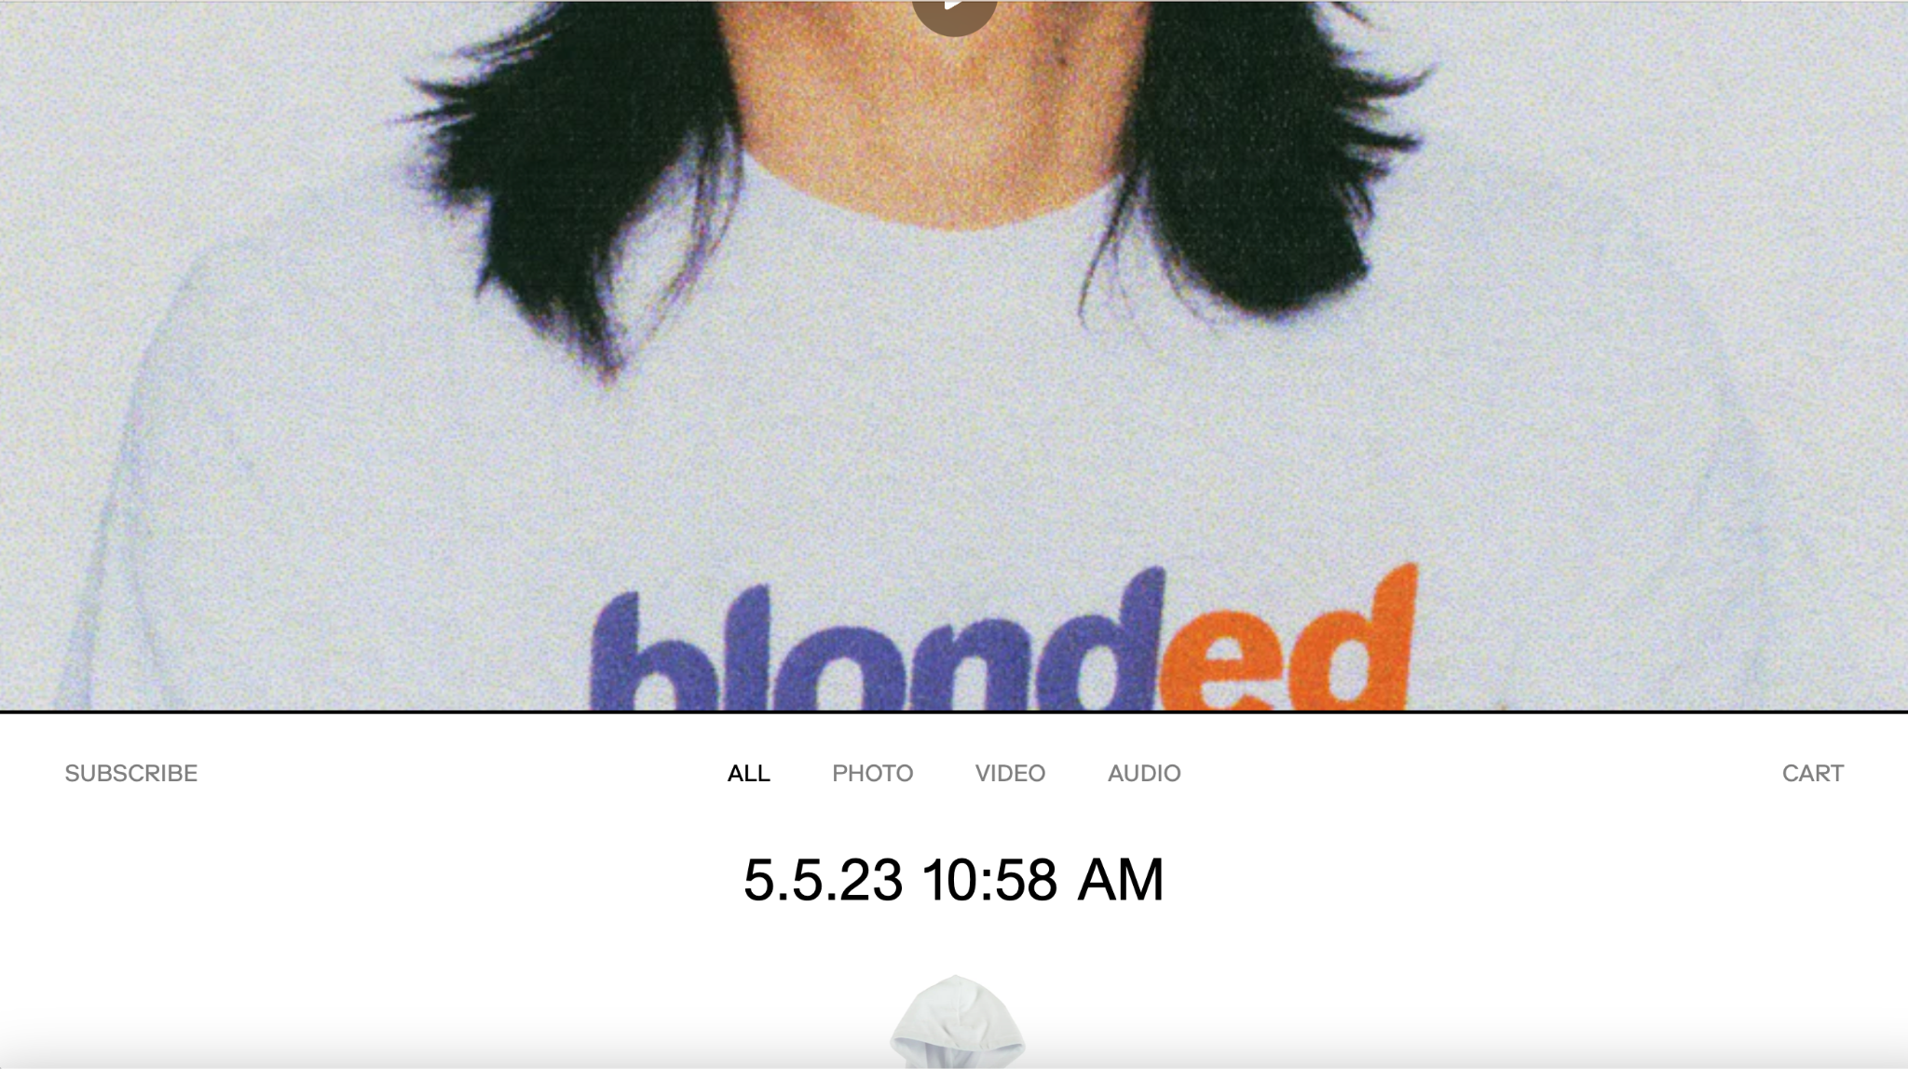
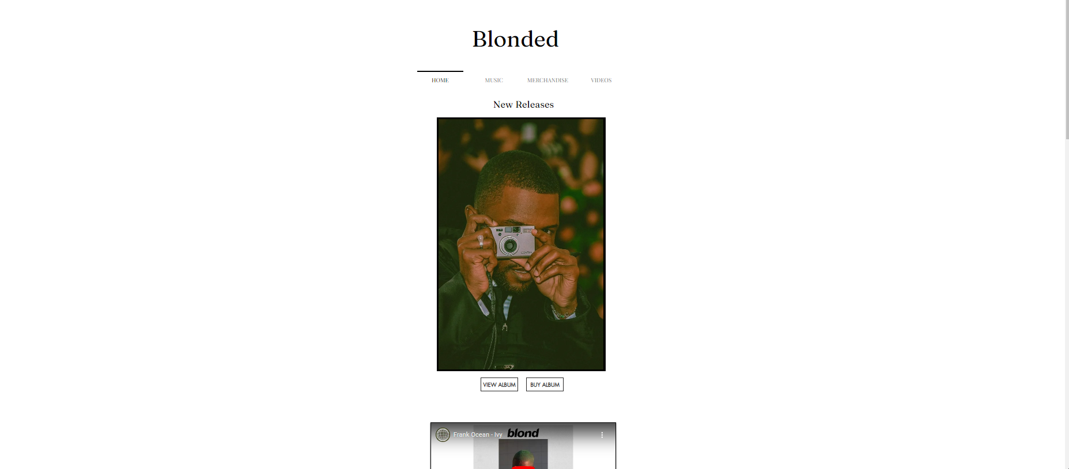
Before
Home Page
After

Slide 18
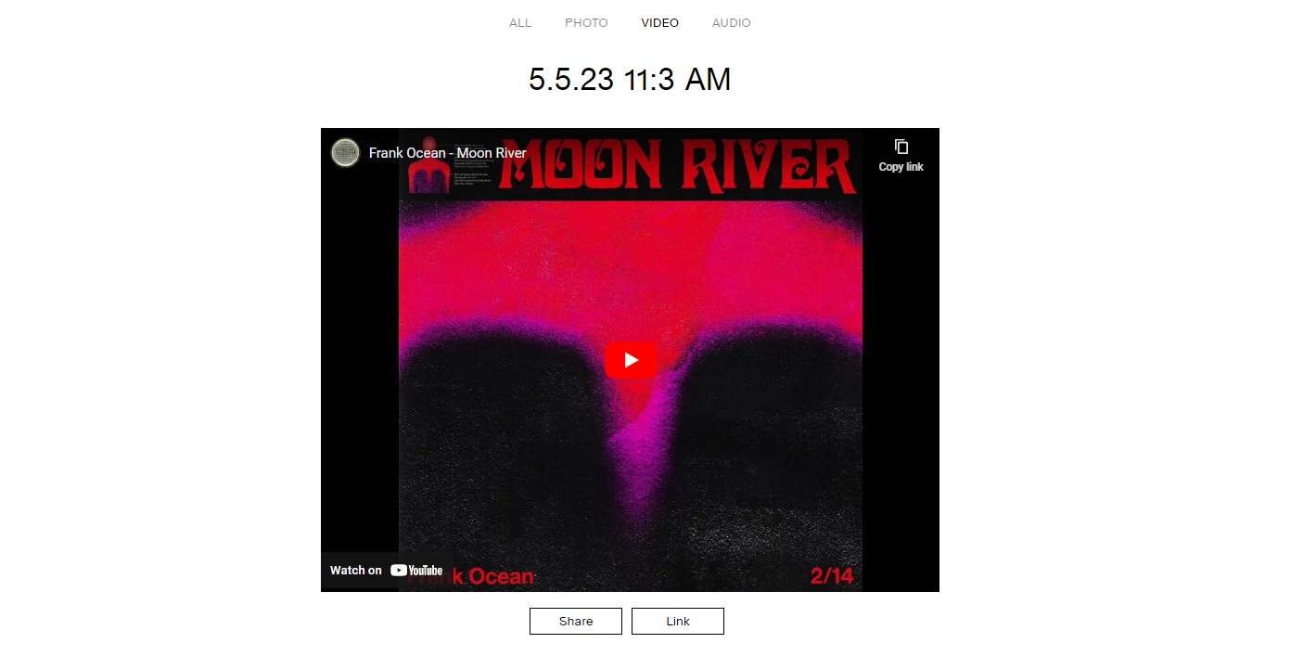
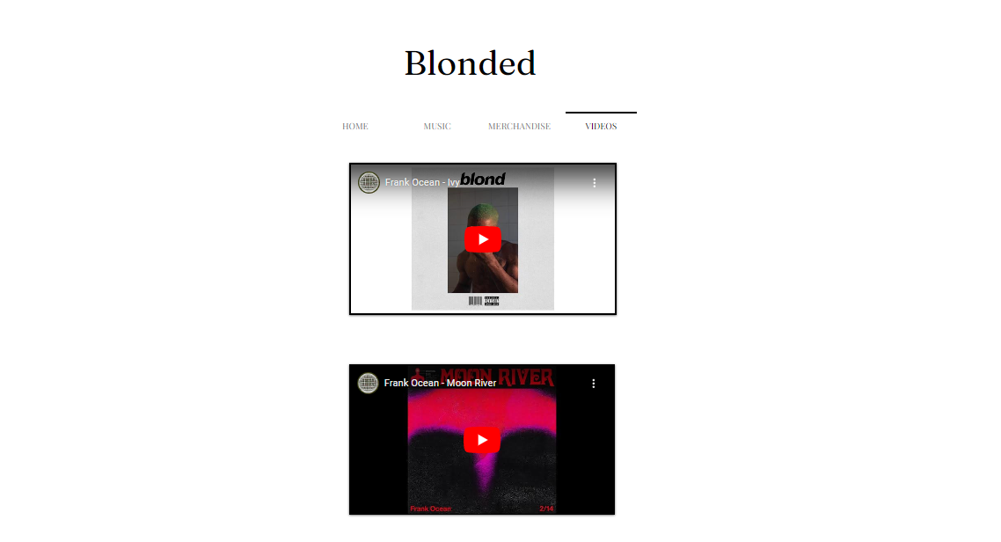
Before
Home Page
After

Slide 19
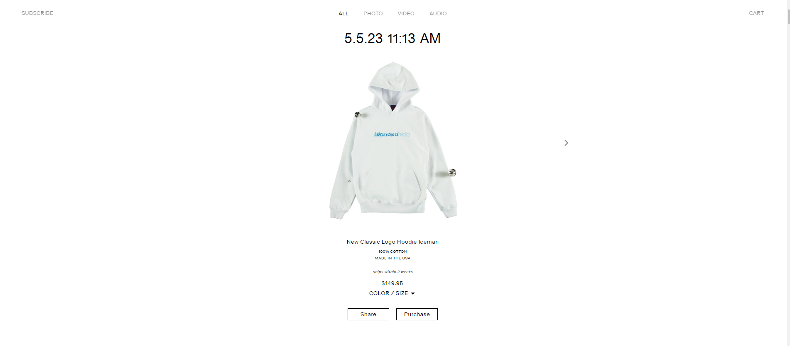
old Merchandise Page

Slide 20

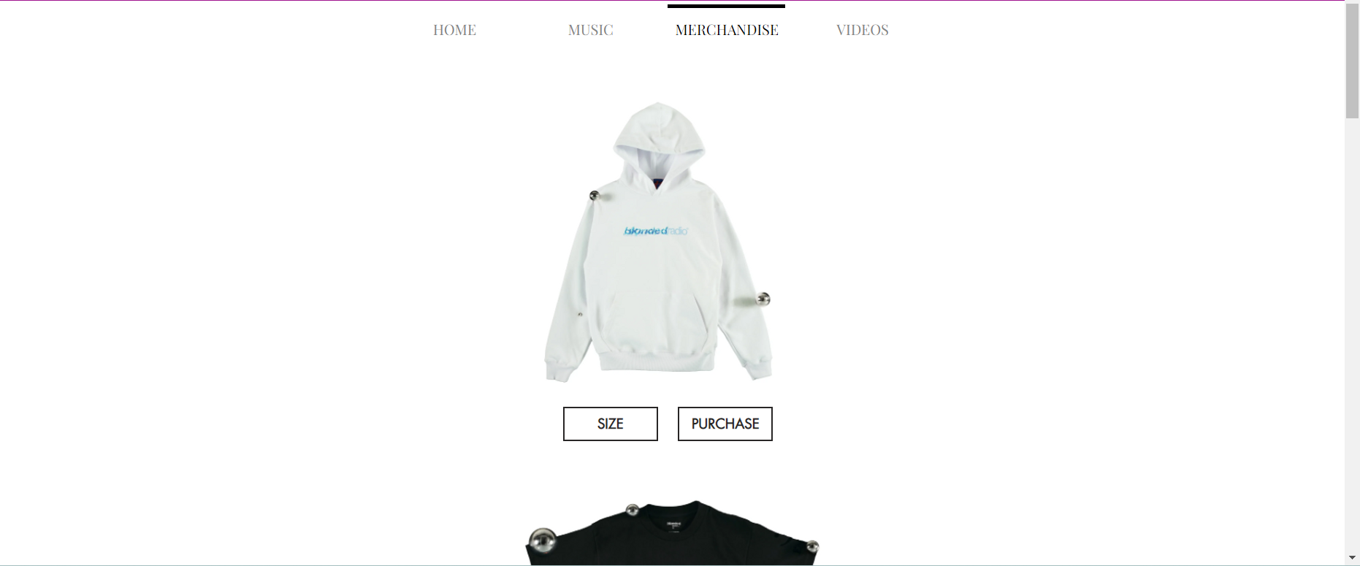
New Merchandise Page

Slide 21
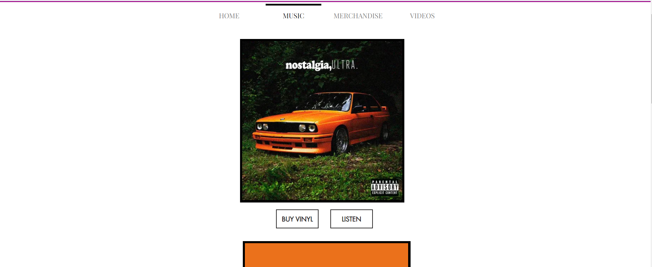
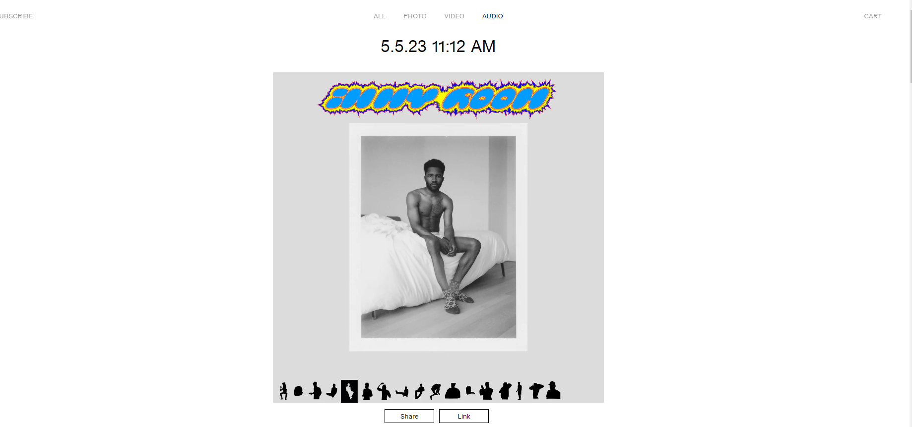

Slide 22
Conclusion
In conclusion, Blonded.co has a visually appealing and minimalist design that is consistent with Frank Ocean's overall aesthetic. The website's information architecture is straightforward and the main navigation is clear, contributing to a positive user experience.
However, there are opportunities for improvement in areas such as content placement, website performance, consistency, mobile responsiveness, and navigation labeling. By addressing these issues and implementing the recommendations provided, Blonded.co can further enhance its user experience and continue to be a popular destination for fans of Frank Ocean and his music.
Redesign website -https://mkc611.wixsite.com/blonded

